Slide 1
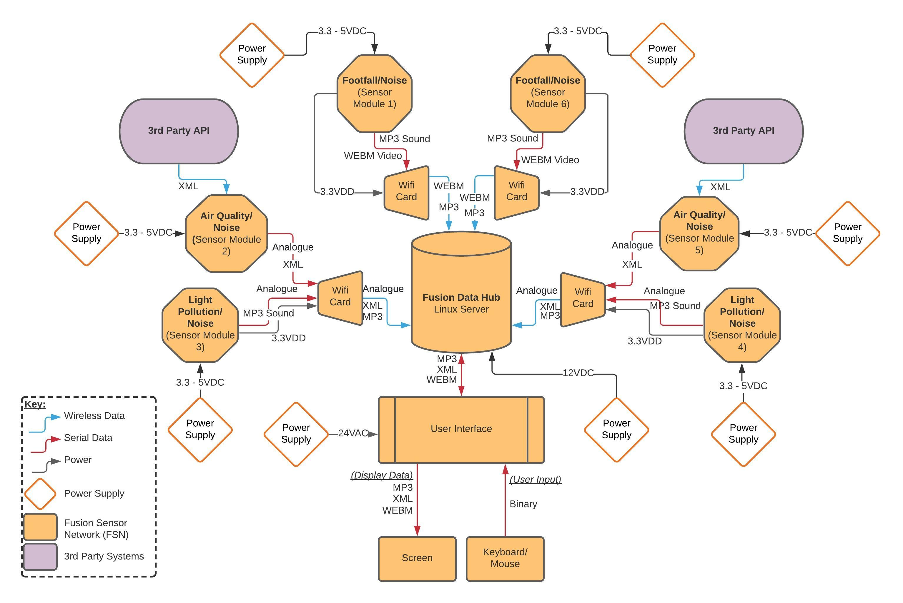

20WSD001 Team Project
[25/10/2020 | Issue 1.0]
Objectives/ Aim (What?)
Fusion are looking to analyze the following scenario: “How Loughborough is environmentally affected by the influx of students during term time”.
Named the “Fusion Sensor Network” (FSN), the system will measure the following variables around
the Loughborough University Campus and
Loughborough Town:
Footfall; Air Quality; Light Pollution; Traffic Noise
Activities (How)
In order to execute the strategy, Fusion have created the following Work Breakdown Structure.
This follows a Systems Engineering Agile framework, with a timeframe for each Programme activity fitting the Gateway meetings.
Budget statement
Fusion’s variable budget of £200 should support the following operating expenses of the FSN:
Purchase of additional Sensors
Purchase of Enclosures for outdoor protection of sensors
Purchase and maintenance of Power Supplies
Purchase of any additional Storage Devices
Purchase of additional Microcontrollers
Programme Key
Assessment criteria compliance
Fusion have compiled a set of System Requirements which are tailored to the network’s Assessment Criteria.
Where applicable, a System Requirement has a “Threshold” and an “Objective” “Measure of Performance” (MOP) which it must meet in order to prove compliance.
A Validation method is outlined as to the testing necessary for the compliance to each requirement.
Stakeholders (Who?)
Fusion are composed of the following Internal Stakeholders:
The Project Support Team (PST): Project Line Management
Azamat Truscott: Engineering Project Manager
Mike Thomas, Matt Gurney and Daniel Poulson: EEE Specialists
Riley Grant: ECS Specialist
Matthew Dick: RMCE Specialist
Project planning 12/10/20 to 06/11/20
Development (4x 3-week sprints) 06/11/20 to 22/01/21
Sensor Integration 22/01/21 to 22/03/21
FSN Data Analysis 22/03/21 to 10/05/21
System Delivery 10/05/21
Key issues and risks
Pre-GW1, Fusion outlined the issues and risks below:
Lack of literature and knowledge of wireless communication - how the sensors would collect data and communicate between themselves and the Data Hub.
Temporary incapacitation of team members due to COVID-19 or personal reasons.
The breakdown of equipment before operation.
Strategy/ Plan (Why?)
Fusion’s plan is to obtain measurements from tailored Sensor Modules and sophisticated 3rd Party systems – these will integrate with the Fusion Data Hub.
Fusion’s Data Hub shall obtain measured data from the Sensor Modules and any 3rd Party systems and output it onto Fusion’s User Display.
Fusion will analyse the data of each variables from the User Display and draw a conclusion to the given scenario.
Team information
GitHub:https://github.com/orgs/lboroWMEME-TeamProject/teams/fusion
JIRA Workflow: https://teamfusion-lboro.atlassian.net/jira/software/projects/SN/boards/1/roadmap
Programme
05/10/20
18/10/20
11/01/21
26/03/21
26/04/21
10/05/21
GW1
GW2
GW3
Autumn Term
Spring Term
Summer Term
Notes:
A version of this is compulsory at each gateway meeting and optional for PST meetings.
In terms of sizing, this should be legible printed on A3, but will probably be viewed on screen. Minimum font size =12
Diagram in the middle should be a top level systems diagram.
The plan will change as the project progresses – that is ok and expected.
Please make sure that the programme element has a key and sufficient detail to be useful.

